Slide 1



HOSPITAL
MANAGEMENT
SYSTEM

Slide 2

INTRODUCTION
The Hospital management system (HMS) is designed for any Hospital to replace there existing manual , paper based system . This system targets to provide complete solution for Hospital and Health care service.
Hospital management system is a computer system that helps to manage the information related to health care.
It manages the data related to all departments of healthcare such clinical , financial , laboratory etc.

Slide 3
The HMS simplifies the work of healthcare professional and their interaction with their patient .
Moreover all the activities in the hospital can be recorded systematically in the digital form .
The HMS system automates the management and reduces the paper work .
It is huge time saver and really facilitates proper communication among the management , staff and the patient .

Slide 4
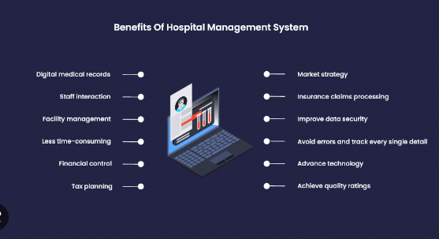

Slide 5

Project description
Scope
patient Registration
appointments scheduling
Billing and payments
Security of the whole system
Pharmaceutical drugs / equipment
Staff management(work roster, availability,scheduling,etc)
Management functions (report generation,accounting, etc)
System administration
Resource allocation(booking rooms, operating theatres)

Slide 6
Literature servey
year | AUTHOR | TITLE | SUMMARY
2022 | CH Yang, W Hsu | A hybrid multiple-criteria decision portfolio with the resource constraints model of a smart healthcare management system for public medical centers | A Smart Healthcare Management System (SHMS) is an intelligent technology integration practice for public medical centers. During the implementation of the SHMS, information on strategy and decision-making problems play an important role in smart hospital development, which directly .
2021 | Naeem Iqbal | A Novel Blockchain-Based Integrity and Reliable Veterinary Clinic Information Management System Using Predictive Analytics for Provisioning of Quality Health Services | The recent advances in information management systems coupled with machine learning algorithms paved the way for a significant revolution in animal healthcare industries. However, the data in such systems suffer from various challenges such as security, reliability, and convenience, to name a few

Slide 7
Year | Author | Title | summary
2018 | Asma khatoon | A Blockchain-Based Smart Contract System for Healthcare Management | Blockchain is evolving to be a secure and reliable platform for secure data sharing in application areas such as the financial sector, supply chain management, food industry, energy sector, internet of things and healthcare. In this paper, we review existing literature and applications available for the healthcare system using blockchain technology.

Slide 8
Proposed Methodology
Basic concepts of c++ has been used in its implementation.
Specially using of linklist played a vital role to create the HMS.
Basic terminologies of hospital management reservation has been care off.

Slide 9
Conclusion
Implementation of hospital management system project helps to store all the kinds of records, provide coordination and user communication, implement policies, improve day-to-day operations, arrange the supply chain, manage financial and human resources, and market hospital services

Slide 10
Thank
you

